Slide 1
Towards a model of poetry writing development
Anthony Wilson and Sue Dymoke
a.c.wilson@exeter.ac.uk
@awilsonpoet
anthonywilsonpoetry.com

Slide 2
Even the poetic world is social.
Bakhtin (1981: 300)
Poets need “not so much an audience, as to feel a need to answer”.
Robert Pinsky (1988: 85)

Slide 3
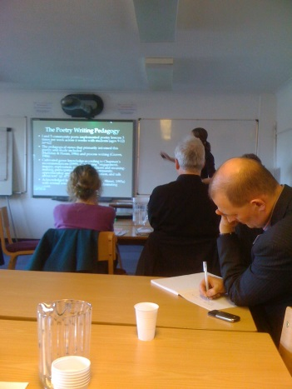
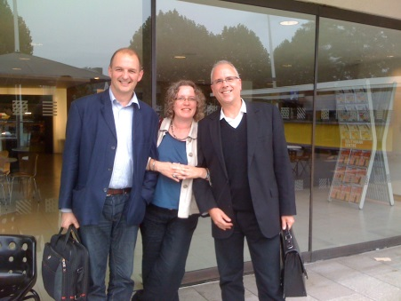
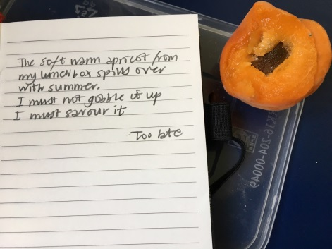

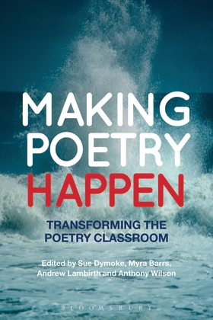
Who are we & what is our research about?
Our own backgrounds & experiences… poet, teachers, teacher educators, INSET providers, researchers, editors, mentors....
We feel that theoretical explanations of learners’ poetry writing development are relatively new and rare, compared to other genres.
Mixed status of poetry in curricula means that poetry writing is not a priority
Neither cognitive models nor expert teacher/poet-practitioners’ accounts fully explore nuances/complexities of learning to write poetry
Social context of learning to write poetry has been missing from the literature

Slide 4
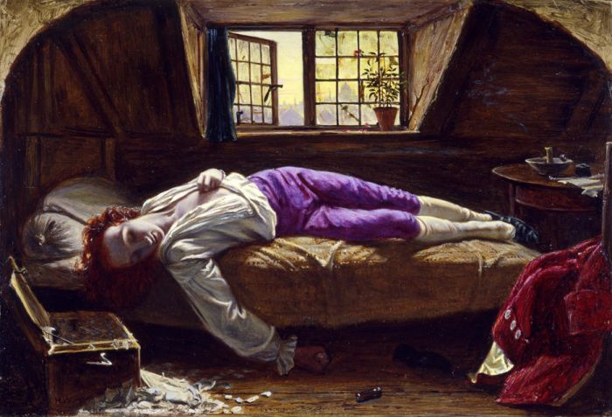
Does this reflect the reality of how poetry is written?
Chatterton (1752-70): Henry Wallis, 1856

Slide 5
Theoretical framework
Vygotskian ideas of socially constructed learning:
  Learning presupposes a social nature, moving from the social world to the individual , via language and “expert others” (1978: 88)
  Learners “growing into the intellectual lives of those around them” (1978: 88-9)
  Distinguishing between “inner and external speech”(1962) - Poetry engages both these planes of thought, moving dynamically between social needs of the writer and private motivations

Slide 6
Bakhtin: The dialogic imagination
Bakhtin (1981):
  Language “overpopulated with the intentions of others” (1981: 294)
  Schultz and Fecho’s notion of classroom language “intermingling” or being in dialogue with culture outside (2000: 53)
  “A dialogic tide”, implying a recursive process that is in a ‘constant state of becoming’ (2000: 53)
  Nystrand et al: all texts are “categorically dialogic” (1997: 14)

Slide 7
How do poets ‘develop’?
Poetry writing is as dependent on the contexts that individuals write in, including their networks of association and personal reading, as much as their changing motivations and identities (Andrews and Smith, 2011).
Poetry writing as a transformational process; that it is an effect of community; and that development can be seen over time, perhaps incorporating other facets of personal development, be they cognitive, social, emotional or intellectual.

Slide 8
Schultz and Fecho’s model
Schulz and Fecho (2000: 55): writing development is:
  reflective of social historical contexts;
  variable across local contexts;
  reflective of classroom curriculum and pedagogy;
  shaped by social interactions;
  tied to social identities;
  conceptualised as a nonlinear process.
  NB: These categories were not created with poetry writing in mind, our original contribution we hope is our adaptation of them for new purposes

Slide 9
Social/historical contexts
Power relationships both “enable and constrain” writers’ “possibilities for self-hood” (Ivanič 1998: 32)
The “watchful gaze” (Boroditskya and Rosen 2015 p.68) of curricula, publishers, government, Ofsted and consequent “fragile space” (Dymoke 2012 p.15) occupied by poetry in assessment-driven curricula
Compton-Lily (2014): Case study of Peter, adolescent African American writer: not all children are born into social structures that enable them to conform to rules and expectations valued on “fields of play” (Bourdieu 1980: 54)

Slide 10
Local contexts
Andrews and Smith (2011): case study of Sean, adolescent poet-performer
Friendship groups operating in and across school boundaries
The importance of feedback in workshops and performances
The impact of informal networks on both Sean’s process: he began “mining” old drafts for new effects; and on his goals: he began to position his writing differently, with much more explicit social goals
Poetry writing as a transference from inner to outer speech

Slide 11
Classroom curriculum & pedagogy
Intellectual lives of teachers have a direct impact on classroom conditions and specific approaches used to teach the genre (Dymoke 2000, Wilson 2010, 2013)
The centrality of the workshop approach (Graves, 1983):
  Inherently social, using a dialogic teaching style (Yates 1999)
  “Energy” of writing in a group can often “force a poem into being” that would not have been written elsewhere (Sansom 1994, p. 67).
  Other poets compared “from the inside” (Carpenter, 2016: 77) as “fellow-practitioners” (Carpenter, 2013: 323), not critics (Cook, 2001)

Slide 12
Social interactions & communities of writers
The benefits of “teamwork” (Schultz and Fecho, 2000: 57)
Schultz (1997): case study of Roderick -
  Inviting others into his network, borrowing from those who joined him
Dyson (2005: 159): case study of Tionna -
  “Unofficial performers for and with [friends] throughout the day”
  How far are these unofficial literacies given credence by policy makers, and in schools?

Slide 13
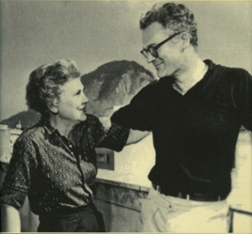
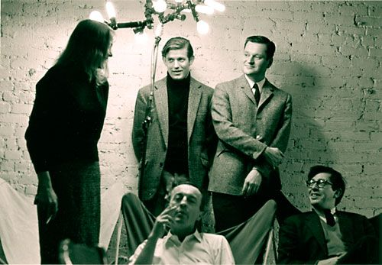
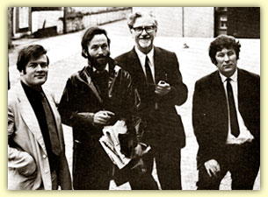
Elizabeth
Bishop
and
Robert Lowell
The New York Poets
Connection between individuals’ progress and the benefits of “teamwork” ? We think this leads to explicit parallel between Vygotsky’s notion of inner and outer speech and individuals’ social engagement with others.
The Belfast Group

Slide 14
Social identities
“Writing is an act of identity in which people align themselves with socio-culturally shaped possibilities of self-hood” (Ivanič 1998: 32)
“If you have no access to the social practice, you don't get in the Discourse, you don't have it” (Gee 2015: 168) -- Heaney merged official & unoffocial poetry/social practices of his life to gain entry?
  Cremin (2006): risk-taking, uncertainty and disorientation of teachers becoming writers
  Dymoke (2017): Spoken Word performers offered membership into a community of writers

Slide 15
A non-linear process of development
The “ludic” and “scavenging” art-form of poetry which learners have “conversations” with (Boroditskaya and Rosen: 2015: 69, 73): amazing potential
Poetry is also demanding: Wilson’s (2009) eighteen-month study of poetry written by primary aged children
  Progress was non-linear, and often looked like nonsense as they “unlearned” the habits of writing prose
  Learners’ organisational schemas need to keep up with other aspects of poetry composition (i.e. layout as well as syntax, word choice, meaning)

Slide 16
From: Wilson, A., & Dymoke, S. (2017). Towards a model of poetry writing development as a socially contextualised process. Journal of Writing Research, 9(2), 127-150. doi:10.17239/jowr-2017.09.02.02

Slide 17
In conclusion…
We want our model of poetry writing development (Figure 2) to reflect:
Sense of journey >>>through the poem>>> in and out of exterior world >>> might involve lengthy travel/time>>> might move through varied contexts>>> might not reach its destination
That for inner speech to become visible in outer speech, in the form of a poem, it has first to enter into an “inner dialogue with ourselves” (Barrs, 2016, p.246)
We argue that this dialogic function of inner speech mirrors and mimics the dialogue inherent in the social contexts in our model

