Slide 1

The Power of Poetry
Anthony Wilson
a.c.wilson@exeter.ac.uk
www.anthonywilsonpoetry.com

Slide 2
There was a word in my throat
with the feeling and I knew the first time
what it meant and I said, it's beautiful.
Yes, she said, and I felt the sound and word
in my hand join the sound and word in hers
as in one name said, or in one cupped hand.
John Logan, from ‘The Picnic’

Slide 3
‘In the rift between what is going to happen and whatever we would wish to happen, poetry holds attention for a space, functions not as distraction but as pure concentration, a focus where our power to concentrate is concentrated back on ourselves.’
Seamus Heaney
The Government of the Tongue (1988: 108)

Slide 4


Slide 5
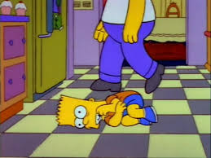

Slide 6
‘C’mon people, this poetry isn’t going to appreciate itself!’
Bart Simpson

Slide 7
Red boots on, she’s got
red boots on,
kicking up the winter
till the winter’s gone.
Kit Wright, from ‘Red Boots On’

Slide 8
EVERYBODY
VERYBODY
ERYBODY
RYBODY
YBODY
BODY
ODY
DY
Y
Michael Rosen, from Did I Hear You Write?

Slide 9
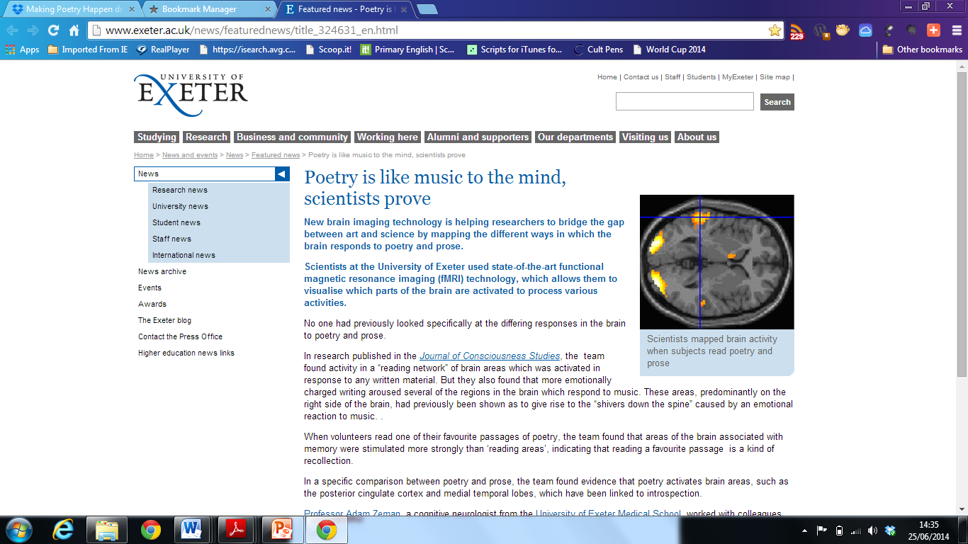
www.exeter.ac.uk/news/featurednews/title_324631_en.html

Slide 10
Wordsworth, on writing poetry: ‘emotion recollected in tranquillity’ (Preface to Lyrical Ballads, 1800)
Keats, on reading poetry: ‘…appear almost a remembrance’ (Letter to John Taylor, 1818)

Slide 11
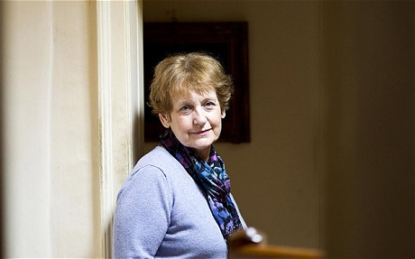

Slide 12
‘The reader should be carried forward, not merely or chiefly by the mechanical impulse of curiosity, or by a restless desire to arrive at the final solution; but by the pleasurable activity of mind excited by the attractions of the journey itself .’
Louise Rosenblatt: 1978: 28

Slide 13

‘Who am I?’
‘Where do I come from?’
‘What makes me, me?’
‘Why am I different in different situations?’
Identity as ‘personal and social bricolage’:
Weber and Mitchell (2008)
Research summary
http://bit.ly/1pRzmqq

Slide 14
‘Spoken word opens opportunities for young people to increase their cultural, social and linguistic capital, including for pupils for whom English is not a first language. It enriches their citizenship with skills of critical enquiry, communication and participation.’
Pete, Spoken Word Poet, London

Slide 15
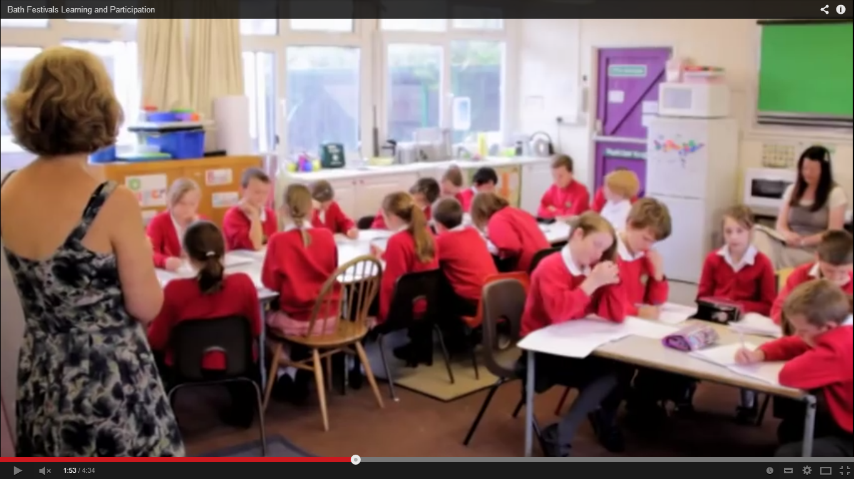

Resources for teachers: http://bit.ly/TlCtd8
Project Report: http://bit.ly/TlCQo6
http://www.youtube.com/watch?v=ilZrZShWBco

Slide 16

‘I have learnt that it is not my job to change a pupil’s thoughts. It is more to ask questions about their ideas, to allow them to go on their own journey of discovery and answer questions which then leads them to ask questions of their own and their writing. This seems to really foster a willingness to redraft, to tweak and improve their writing. I always tried to steer their writing too much, before. Now they own it rather than me.’
Write Team teacher

Slide 17
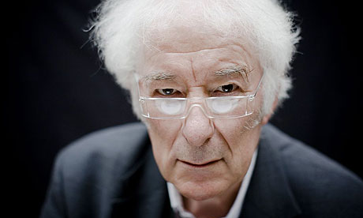
‘Poetry holds attention for a space, functions not as distraction but as pure concentration, a focus where our power to concentrate is concentrated back on ourselves.’
Seamus Heaney, 1988: 108

Slide 18
References
Auden, W.H. (2007). Collected Poems (Ed. E. Mendelson). New York: Random House, Inc.
Collins. J (1998). ‘Playing Truant in the Mind: the social exclusion of quiet pupils’. Research paper given at the British Education Research Association Annual Conference, Queen’s University Belfast.
Cropley, A. J. (2001) Creativity in Education and Learning: a guide for teachers and educators. London: Kogan Page.
Dunn, S. (2001). Walking Light: Memoirs and Essays on Poetry (New Expanded Version). Rochester, NY: BOA Editions.
Heaney, S. (1980), Preoccupations: Selected Prose 1968-1978. London: Faber and Faber.
Heaney, S. (1988), The Government of the Tongue: The 1986 T.S. Eliot Memorial Lectures and Other Critical Writings. London: Faber and Faber.
Krashen, S. (1982). Second Language Acquisition and Second Language Learning. Oxford: Pergamon.
Rosenblatt, L. (1978) The Reader, the Text, the Poem. Carbondale IL: Southern Illinois University Press.
Sainsbury, M. (2009). Developing Writing in a High-Stakes Environment. In R. Beard, D. Author, J. Riley, and M. Nystrand (Eds.), The Sage Handbook of Writing Development (pp. 545-560). London: Sage.
Vygotsky, L.S (1986) ed. A.Kozulin, Thought and Language. Cambridge, MA: The MIT Press.

